Slide 1



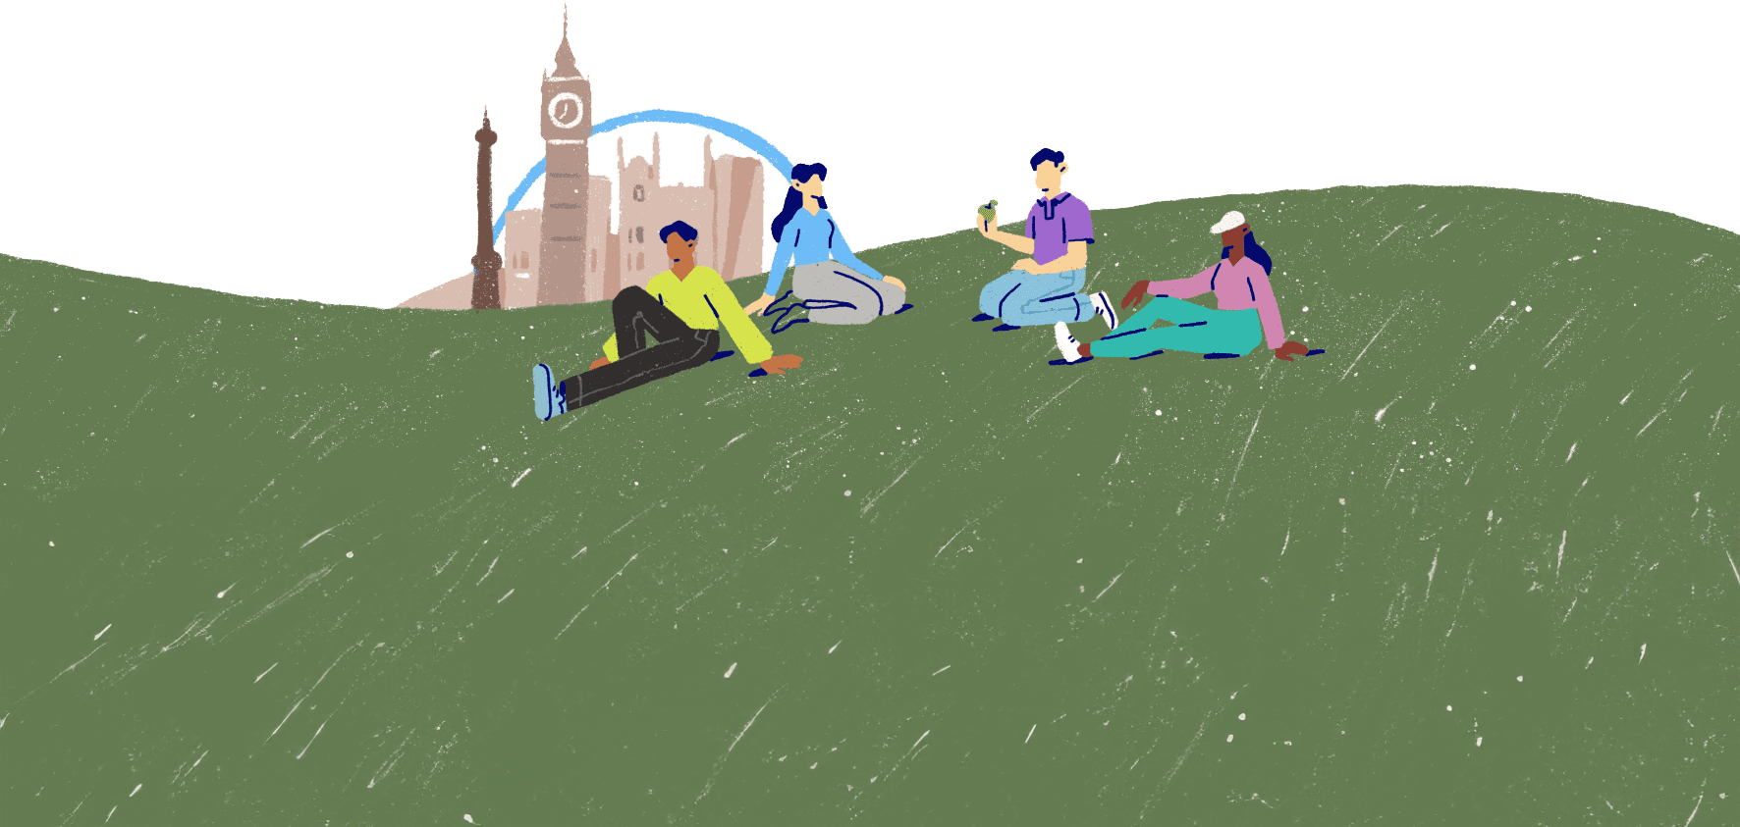
Coping strategies
Lesson 7

Slide 2

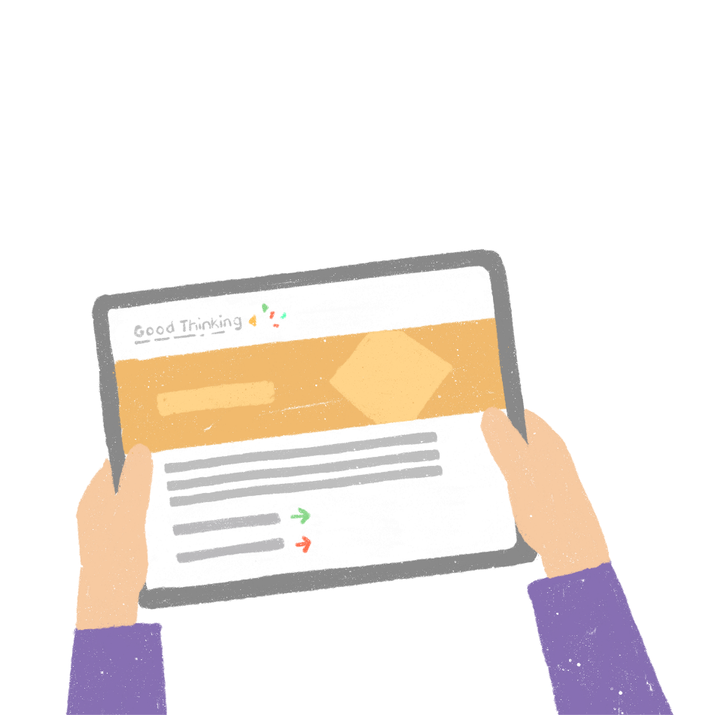

Dealing with difficulties
How we react to tough times is personal to us and may depend on how we're already feeling at the time.
The coping strategies we use can also vary depending on what's happened, how we're feeling and how well strategies we've used in the past have worked for us.
What are some coping strategies people might use to cope with a challenging situation?​

Slide 3
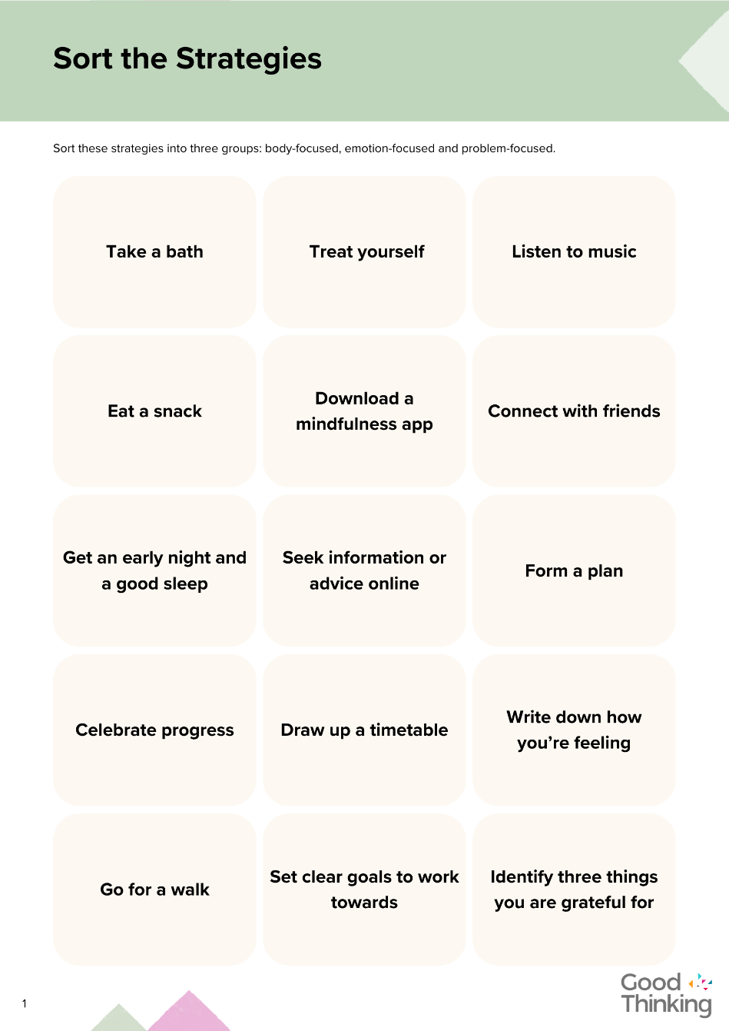
Different sorts of strategies
There are many coping strategies that people use, and a combination of strategies is often most effective.
Some of these are body-focused, some are emotion-focused, and some are problem-focused.
See if you can sort the coping strategies into these three categories.

Slide 4
Different sorts of strategies
Body-focused strategies
Take a bath
Go for a walk
Eat a snack
Quality sleep
Listen to music
Emotion-focused strategies
Connect with friends
Write down your feelings
Practice gratitude
Practice mindfulness
Treat yourself
Celebrate progress
Problem-focused strategies
Form a plan
Draw up a timetable
Set clear goals
Seek information and advice
Some strategies will fit into more than one category. For example, we use our sense of hearing to listen to music, but it can directly impact our emotional state.

Slide 5


How we cope
Photo from Canva
Can you suggest occasions when each of the strategies you have sorted might be particularly effective?
Remember – there is no right or wrong answer. Different people will find some strategies more helpful than others.

Slide 6

"We do not have to become heroes overnight. Just a step at a time, meeting each thing that comes up, seeing it not as dreadful as it appears, discovering that we have the strength to stare it down."
Eleanor Roosevelt
Photo by Ashley Batz on Unsplash

Slide 7


